Slide 1



TradeLens: Intra-IIFT Case Challenge GTO
Identifying a Potential FTA For India To Maximize Economic Gains
Team INCOTERMS
Aditya Partap Singh
Class of ‘24
Sajal Vats
Class of ‘24

Slide 2
Product selection : Trade indicators will aid in the identification of products that would benefit from diversification in export destinations
Regional Hirschman Index (RHI) of India’s export
Revealed Comparative Advantage (RCA) of high RHI HS codes
For products with declining RCAs, we look at world import demand
For any country, RHI of a product measures the concentration of export destinations.
RHI values are generally calculated at the chapter level, i.e., at the 2-digit HS code
RHI value >0.5 denotes concentration and signals potential for export destination diversification
RCA provides an indication of a country’s export competitiveness. It is based on the Ricardian trade theory
RCA values are calculated at 6-digit levels. Generally, a 5-year trend of RCA values is analyzed to weed out any anomalies
RCA value >1 denotes competitive advantage and robust government support
A drop in the world import demand can lead to the decline in RCA. Hence looking at the 5-year trend of import demand becomes critical
Among the 6-digit codes with declining RCA, only 262091 has a drop in world import demand. This could be due to presence of restricted elements like beryllium
Scatter chart of RHI of India’s export at chapter level
RCA analysis of the 8 HS codes with RHI>0.5
Detailed RHI excel calculation attached in Annexure 1
High RHI values denote need for diversification. We only look at products with RCA>1 as other products don’t have competitive advantage over L2 players (other exporters)
Further, for products with RCA>1, we focus on the ones with declining or stagnant RCA over a 5-year period as they would gain the most from diversification
For a few remaining HS codes, we look at the L2 players export destinations
Code | Major L2 players
160521 | Vietnam, Indonesia, China
430390 | China, Italy, France
780110 | Korea, Australia, China
RHI >0.5
When RCA declines for two consecutive years, it creates a declining trend
For the above HS codes, export destinations of the L2 players include countries with whom India already has an FTA or similar arrangement
Chapter Level | 6-digit level products with declining RCA trends
1 | None
5 | None
16 | 160521
26 | 262091
43 | 430390
57 | 570500, 570390, 570249, 570239,570220,570210
67 | 670330
78 | 780110
For codes 670330, 570239, 570390, 570220, 570210 : India is 1st in exports. FTA won’t add much value
Out of 99 2-digit HS codes, 8 codes have RHI>0.5.
These codes are : 01|05|16|26|43|57|67|78
The remaining codes, 570500 and 570249, would need further scrutiny
Product selection
Country selection
Bilateral relations
Trade creation & welfare
Annexure

Slide 3
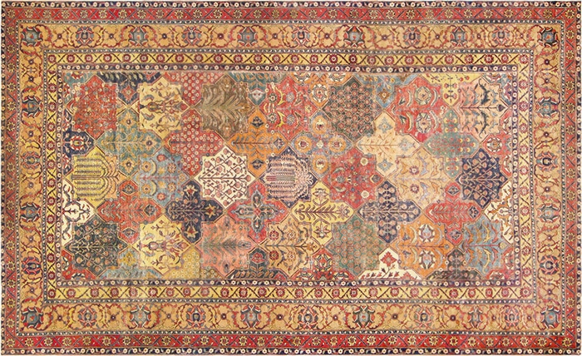
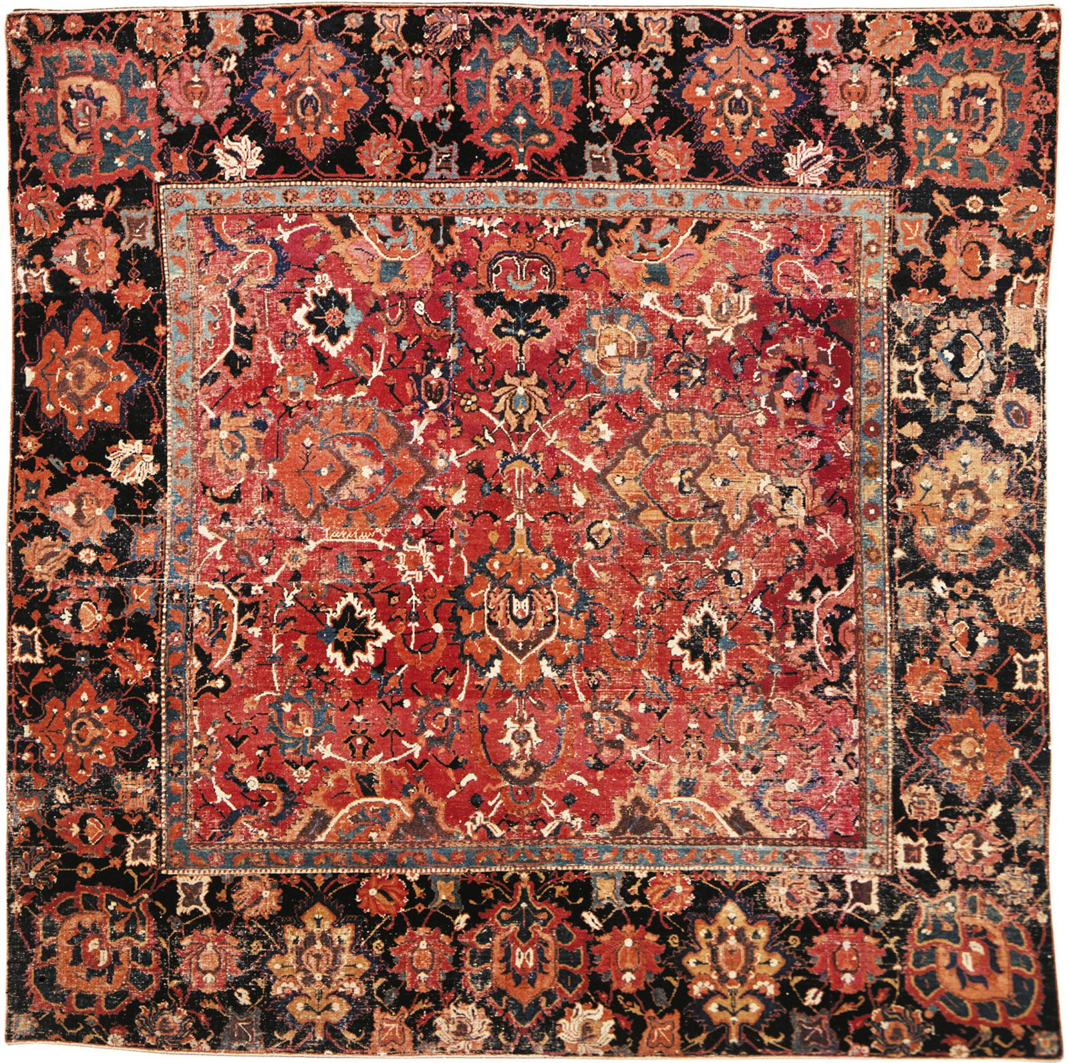
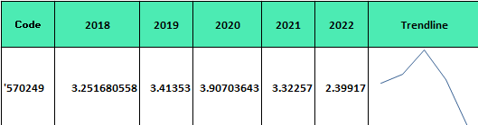
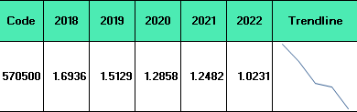
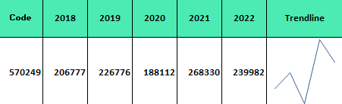
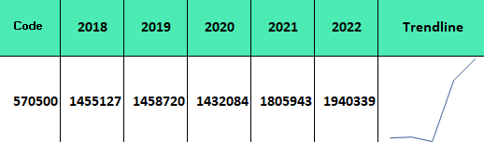
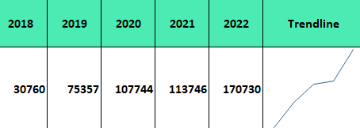
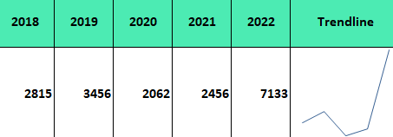
Comprehensive evaluation of 570249 and 570500 as potential commodities to be covered under FTA
Chapter 57 has an export RHI of 0.59 for India. Diversification of export destinations would reduce risk
570249: Carpets and floor coverings of vegetable material or animal hair
(made up, woven, not tufted)
570500 : Carpets and other textile floor coverings, whether or not made up
(excluding knotted, woven or tufted)
RCA value 5-year trend (2018-22) : Steep decline
RCA value 5-year trend (2018-22) : Steep decline
World import demand value (USD thousands) trend : Largely rising
World import demand value (USD thousands) trend: Rising
For both codes, Iraq is one of the major export destinations of these L2 players. And India doesn’t have an FTA with Iraq
Major L2 players of this code include Turkey, Vietnam, China
Major L2 players of this code include China, Egypt, USA
Iraq majorly imports 570249 from Turkey and 570500 from China, Turkey. Iraq's lack of FTA with these nations creates an opportunity for India
570500: Iraq import demand value trend
(2018-22): Rising
570249: Iraq import demand value trend
(2018-22): Rising
Rising import demand of Iraq gives India a huge market to tap into
With India getting an opportunity to arrest the declining RCAs, Iraq also stands to benefit from this FTA
Import RHI of Iraq for 570249 is 0.999 and for 570500 is 0.984
This shows Iraq’s heavy dependence on a few countries for its imports
The FTA with India will provide Iraq scope for diversification
Product selection
Country selection
Bilateral relations
Trade welfare & creation
Annexure

Slide 4
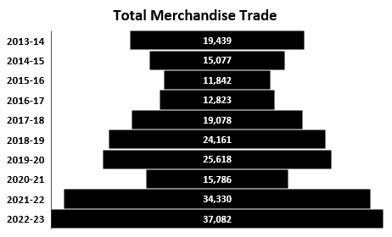
Cordial bilateral relationship between India and Iraq traces back decades across trade, politics, business, and technology
Merchandise Trade analysis between India and Iraq
Political Relations and Inter-governmental coordination
Business Interests and Tourism
The invasion of Iraq did slow the goods trade, but it revived post 2010 mainly due to crude oil imports
The value of the trade in FY23 has reached close to $37 billion which encompasses 3.32% of India’s total merchandise trade.
The one worry here is that the surplus here in favor of Iraq is around $32 billion(due to crude) and it is here that we identify potential to bridge the gap.
Even though Russia has surpassed Iraq as our largest crude supplier, imports from Iraq still account for close to 1 million bpd (22% of our import requirements)
Since the war in 2003, India has been supporting free, democratic, pluralistic, united and federal Iraq
Responding to the urgent needs of post war reconstruction, India committed $20 Million in 2003 on UN secretary General’s request
Iraq has proposed to set up an Iraqi Friendship group in Indian Parliament to enhance cooperation and exchange experiences
The bonhomie has resulted into India becoming one of the most preferred destinations for Iraqis seeking quality medical treatment
In 2022, about 33000 medical visas were issued to Iraqi citizens for treatments in India
Iraq’s pharmaceutical companies have participated in various trade promotion events in India
India and Iraq did sign a Friendship treaty in 1952 which has been the bedrock of their relationship over the years
Iraq unveiled a special postage stamp in 2022 to celebrate 70 years of this treaty and 75 years of Indian Independence
(In US$ million)
Capacity Building and Tech Transfer
People to People Contacts and Cultural influences
India has annually been aiding Iraq under the Indian Technical and Economic Cooperation (ITEC) programme to train officials of the Government of Iraq.
The Indian Oil Corporation Limited (IOC) has provided training in India to the Iraqi oil officials in various subjects related to downstream oil sector
Around 40000 Indians undertake pilgrimages to the holy towns of Karbala, Najaf and Baghdad every year
Before the 1991 Gulf war there were more than 80000 Indians in Iraq and even though it has reduced in recent times, the number is still close to 20000
Iraqi philosophers and Sufi saints like Khwaja Hasan al Basri, Junaid Al Baghdadi and Sheikh Behlul have influenced spiritual movements in India as even Guru Nanak travelled to Iraq to meet Behlul
Product selection
Country selection
Bilateral relations
Trade creation & welfare
Annexure

Slide 5
Courtesy the FTA between India and Iraq, there will be trade creation and net welfare gains of Iraq due to India’s exports
Trade creation refers to the economic benefits that arise when countries eliminate tariffs and other barriers for the movement of goods and services across borders
For the 2 selected HS codes:
Schematic diagram depicting the impact of FTA on the Iraqi market
Post FTA, there would be a gain in consumer surplus and welfare for the Iraqi market
Price ($)
The average price of Indian carpets is $400
The MFN duty on carpets is 6%
Prior to FTA, Indian carpets will cost $424 in Iraqi markets. Post FTA, cost will reduce to $400
The consumer surplus rises by (1+2+3+4+5). The surplus as per the diagram is $900
The domestic producer surplus drops by (1+2). The loss as per the diagram is $180
The loss in the Iraqi govt tariff revenue is (4). The loss as per the diagram is $480
The net gain in welfare can be calculated as [(increase in consumer surplus) – (tariff revenue and producer surplus)]
The net welfare gain is given by (3+5). This equals $240 as per diagram. Actual value would depend on elasticity
Since the supply and demand of carpets is relatively elastic, the value of net welfare would be large
Demand of Iraq
Domestic Supply of Iraq
$400 + 6%($400)
=
$424
(Supply from India)
+
(Tariff)
Iraq buys around 20 units of carpets currently (2020-22). Domestic supply assumed
Post FTA, we assume a 100% rise in quantity sold to 40 units in the short run
In the long run, we expect trade volume to rise further as India has an impressive Export Propensity Index of 1.05% in HS 57
1
2
3
4
5
(Supply from India)
$400
5
10
30
45
Quantity (units)
Trade diversion happens when a country joins a free trade area with a common external tariff. This may cause imports to shift from low-cost countries to high-cost countries
Since no such arrangement is planned for this FTA, there would be no trade diversion
Product selection
Country selection
Bilateral relations
Trade creation & welfare
Annexure

Slide 6
APPENDIX
Excel based calculations
S.No. | Name of File | File attached | Description
1 | RHI_calculation_(HS code 1 to 97) |  | Detailed calculations of India's Export RHI for all HS codes
2 | RCA_calculation |  | Detailed calculation of RCA values at 6-digit level of the selcted HS codes
3 | Import RHI_Iraq |  | Import RHI calculation of Iraq for 570249 and 570500
RCA formula
(Export of 6-digit HS code from India to world)
(Export of that 2-digit chapter from India to world)
(World export of that 6-digit code)
(World export of that 2-digit code)
EPI formula
(Export of 2-digit HS code from India to world)
(Contribution of 2-digit HS code to India’s GDP)
REFERENCES
http://www.amit-sengupta.com/welfare-effects-regional-trade-agreement-rta-international-trade-economics/
https://www.eoibaghdad.gov.in/page/india-iraq-relations/
Product selection
Country selection
Bilateral relations
Trade creation & welfare
Annexure

